Slide 1

THE BEST LOCATION FOR A MEXICAN RESTAURANT IN MADRID
JOÃO NASCIMENTO

Slide 2






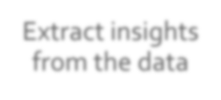






In this project we will determine the best location for a mexican restaurant
Work the data
Extracting the data from the Madrid’s City Hall and the Foursquare API.
Analyzing the results and extracting conclusions.
Making a segmentation by neighborhood and population characteristics in Madrid (Clustering).
Extract insights from the data
Get the data

Slide 3
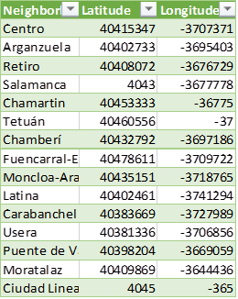
Get the data (API)
To do so, we needed to:
Create a second dataframe
Include the neighborhoods’s names
Add the latitude and longitude of each neighborhood

Slide 4
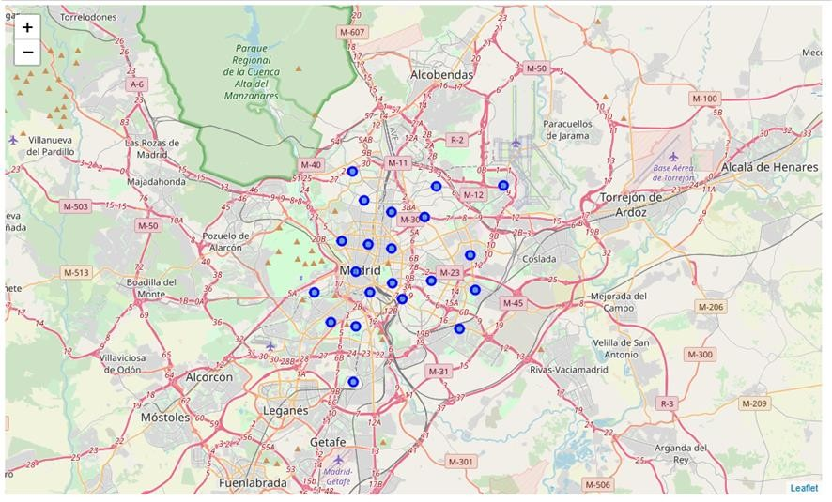
The neighborhoods on a map

Slide 5
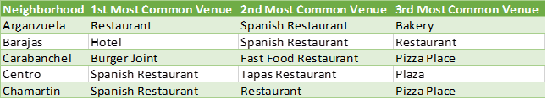
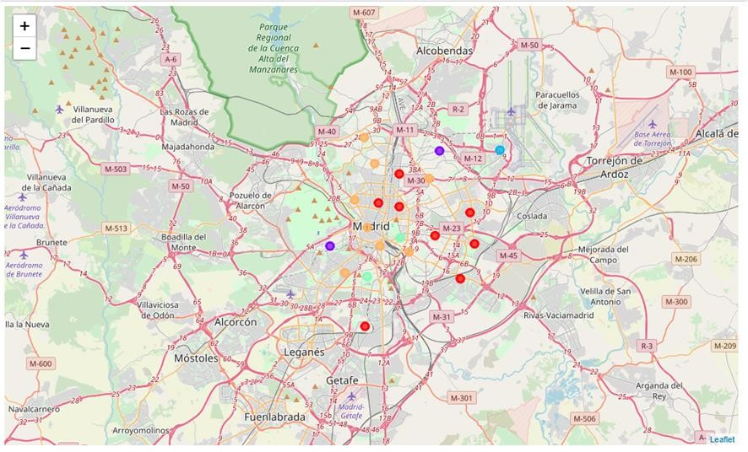
A dataframe containing the most common venues by neighborhood
After obtaining these data, clusters could be made:

Slide 6
Conclusions
If we want to open a new Mexican restaurant in Madrid, we need to study the population in that area. If we exam cluster 1, we notice that the population are mostly Latinos, (South American countries), and Latin restaurants can be found, like Argentinian restaurants, tapas restaurants, as well as Italian restaurants. On the other hand, clusters 4 and 5 would make a good match. Looking at the venues in these clusters, it is possible to find one Mexican restaurant, and a good bunch of fast food, Argentinian, and south American restaurants. To conclude, these clusters would be a good place to open our Mexican restaurant.

